Slide 1
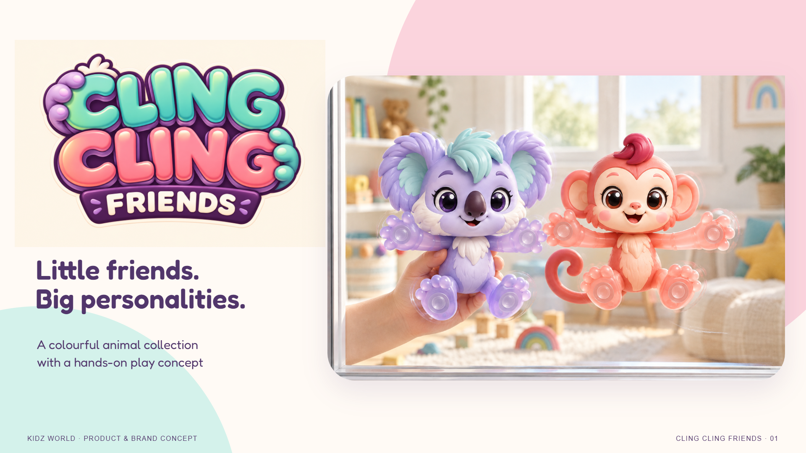
Notes:
[Sources]
KIDZ WORLD selected character direction: 01_Concept/Fantasy_Animals_Collection_v01.png; refinement Collection_v02. Logo: 02_Branding/Cling_Cling_Friends_Logo_v02.png (concept). Lifestyle: 03_Lifestyle, window and desk v01 (concept renders; size illustrative).
User explicitly requests a conceptual PPT with image-based slides. Four species selected for development, not production approval. Name/logo and contact mechanism remain proposals. No dimensions, age, price or packaging claim.
Play intent source: 05_Development/Cling_Cling_Friends_Play_Feasibility_v01.md. No physical prototype tested.

Slide 2
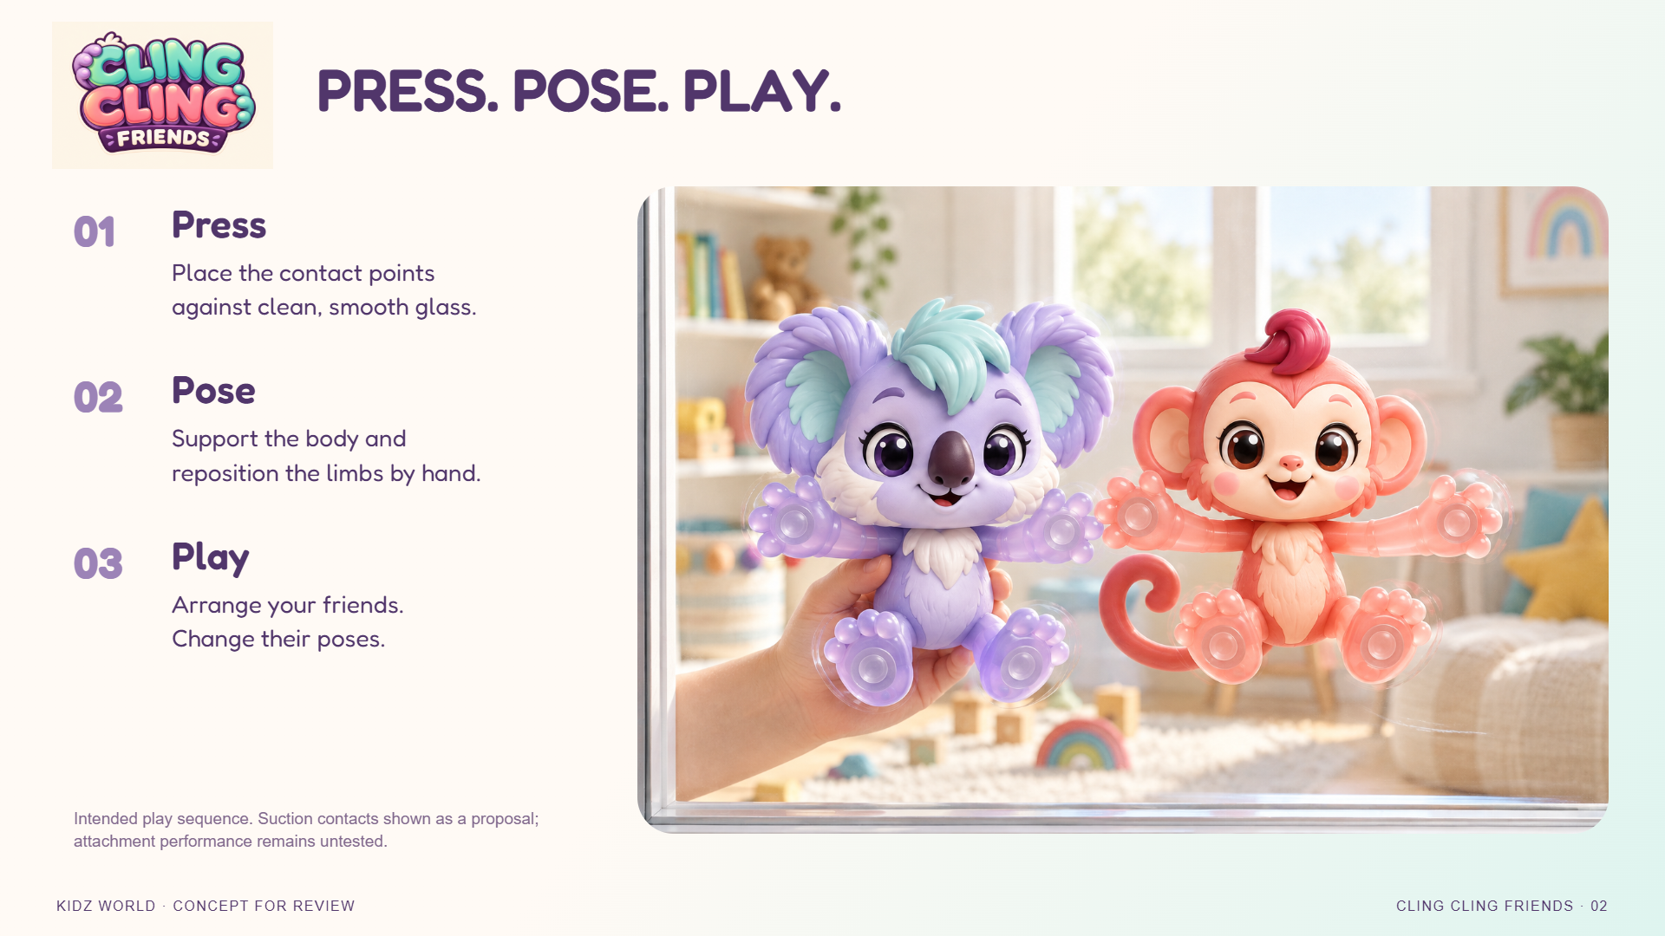
Notes:
[Sources]
KIDZ WORLD selected character direction: 01_Concept/Fantasy_Animals_Collection_v01.png; refinement Collection_v02. Logo: 02_Branding/Cling_Cling_Friends_Logo_v02.png (concept). Lifestyle: 03_Lifestyle, window and desk v01 (concept renders; size illustrative).
User explicitly requests a conceptual PPT with image-based slides. Four species selected for development, not production approval. Name/logo and contact mechanism remain proposals. No dimensions, age, price or packaging claim.
Play intent source: 05_Development/Cling_Cling_Friends_Play_Feasibility_v01.md. No physical prototype tested.

Slide 3
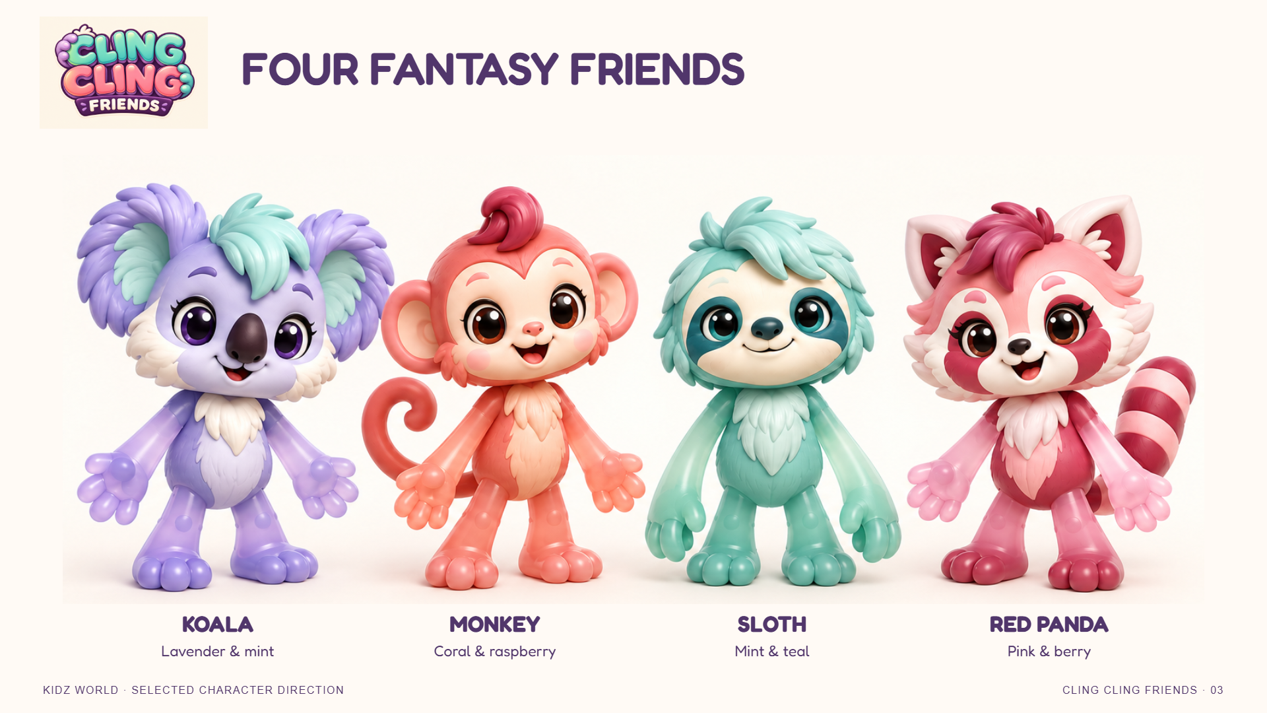
Notes:
[Sources]
KIDZ WORLD selected character direction: 01_Concept/Fantasy_Animals_Collection_v01.png; refinement Collection_v02. Logo: 02_Branding/Cling_Cling_Friends_Logo_v02.png (concept). Lifestyle: 03_Lifestyle, window and desk v01 (concept renders; size illustrative).
User explicitly requests a conceptual PPT with image-based slides. Four species selected for development, not production approval. Name/logo and contact mechanism remain proposals. No dimensions, age, price or packaging claim.
Play intent source: 05_Development/Cling_Cling_Friends_Play_Feasibility_v01.md. No physical prototype tested.

Slide 4
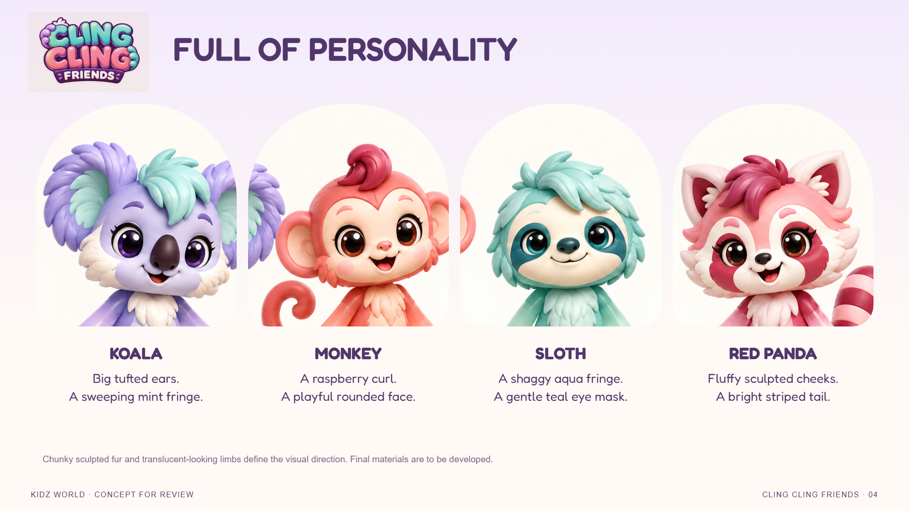
Notes:
[Sources]
KIDZ WORLD selected character direction: 01_Concept/Fantasy_Animals_Collection_v01.png; refinement Collection_v02. Logo: 02_Branding/Cling_Cling_Friends_Logo_v02.png (concept). Lifestyle: 03_Lifestyle, window and desk v01 (concept renders; size illustrative).
User explicitly requests a conceptual PPT with image-based slides. Four species selected for development, not production approval. Name/logo and contact mechanism remain proposals. No dimensions, age, price or packaging claim.
Play intent source: 05_Development/Cling_Cling_Friends_Play_Feasibility_v01.md. No physical prototype tested.

Slide 5
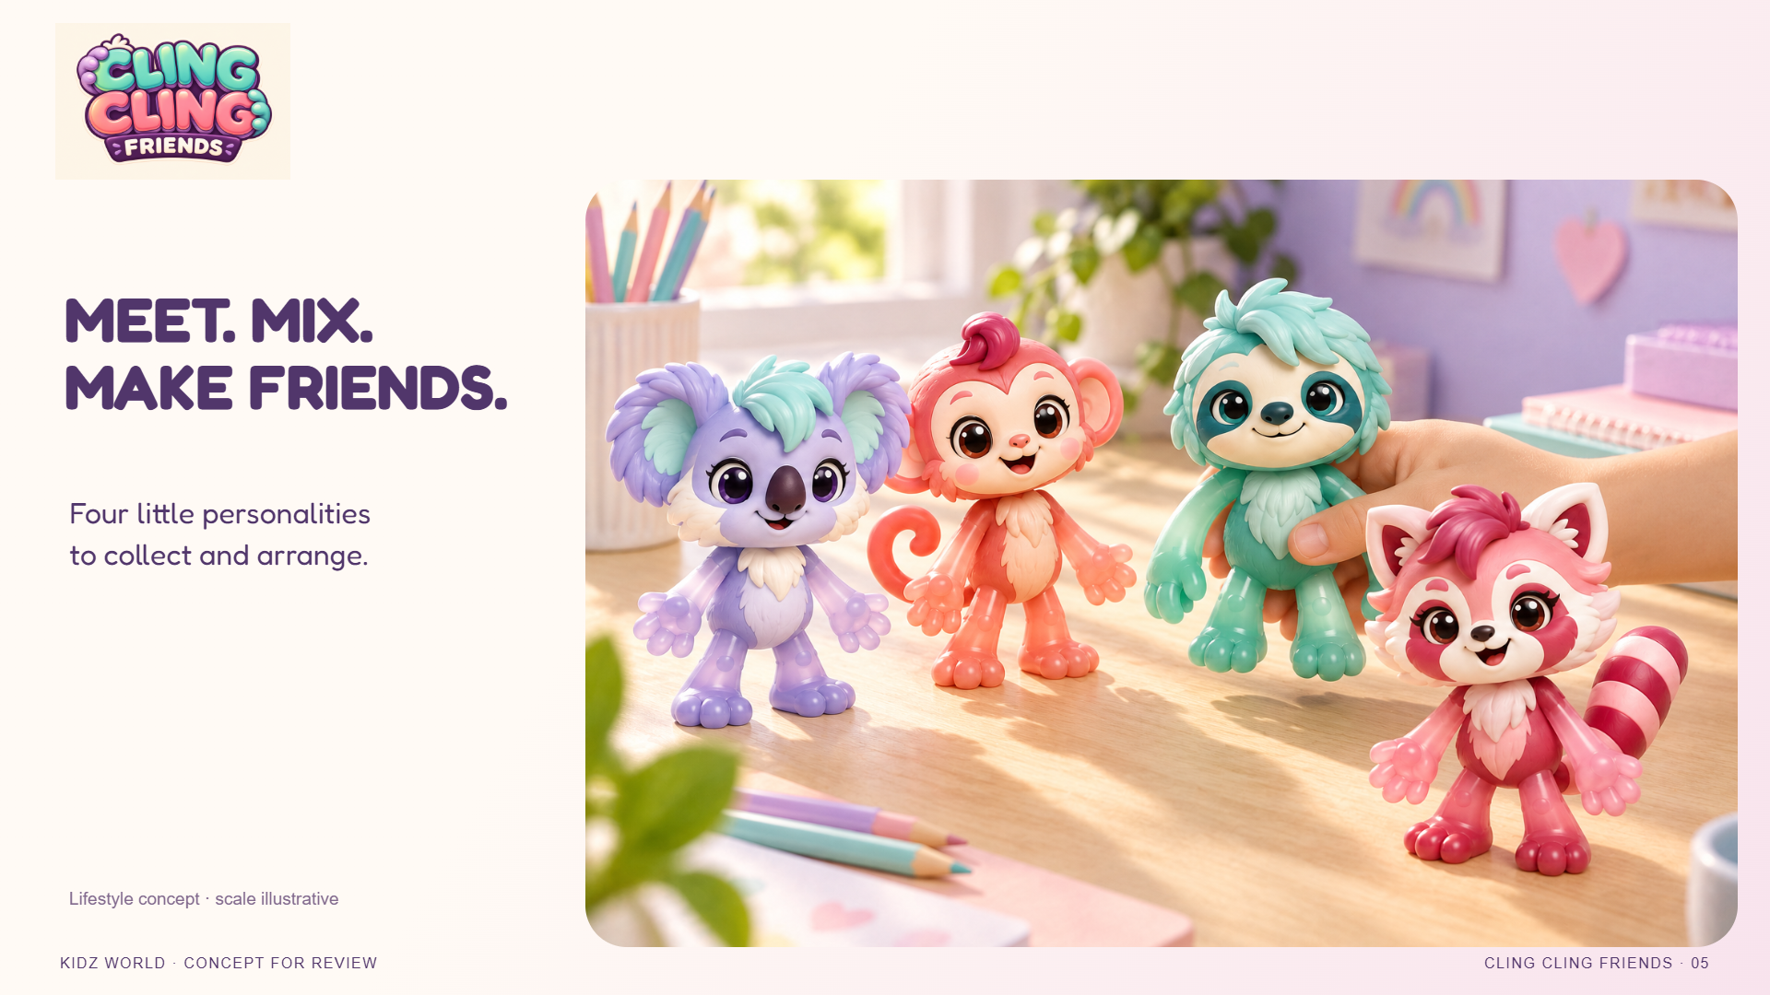
Notes:
[Sources]
KIDZ WORLD selected character direction: 01_Concept/Fantasy_Animals_Collection_v01.png; refinement Collection_v02. Logo: 02_Branding/Cling_Cling_Friends_Logo_v02.png (concept). Lifestyle: 03_Lifestyle, window and desk v01 (concept renders; size illustrative).
User explicitly requests a conceptual PPT with image-based slides. Four species selected for development, not production approval. Name/logo and contact mechanism remain proposals. No dimensions, age, price or packaging claim.
Play intent source: 05_Development/Cling_Cling_Friends_Play_Feasibility_v01.md. No physical prototype tested.

Slide 6
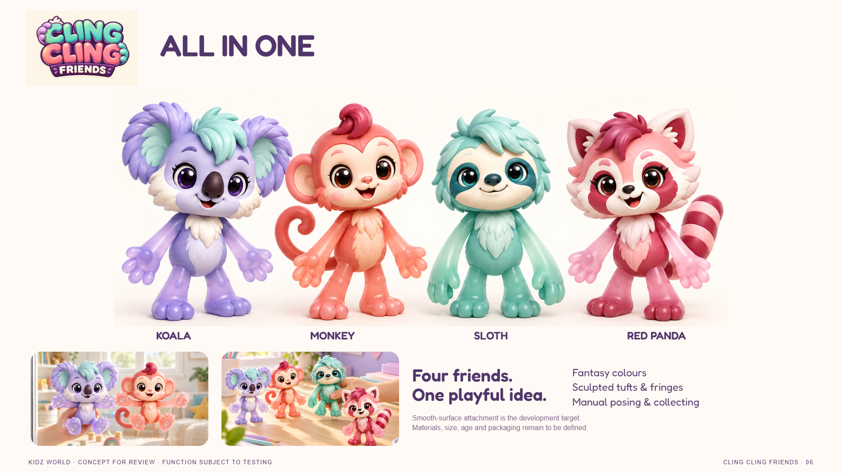
Notes:
[Sources]
KIDZ WORLD selected character direction: 01_Concept/Fantasy_Animals_Collection_v01.png; refinement Collection_v02. Logo: 02_Branding/Cling_Cling_Friends_Logo_v02.png (concept). Lifestyle: 03_Lifestyle, window and desk v01 (concept renders; size illustrative).
User explicitly requests a conceptual PPT with image-based slides. Four species selected for development, not production approval. Name/logo and contact mechanism remain proposals. No dimensions, age, price or packaging claim.
Play intent source: 05_Development/Cling_Cling_Friends_Play_Feasibility_v01.md. No physical prototype tested.

